Slide 1

Awesome AI Scholar
By Team Awesome
Ali Murtaza Shaikh, David Stevens, Aaron Buxbaum
Notes:
Hello and welcome to the final project presentation of our educational tech project.
I am Ali and my team members are David and Aaron , together we are team awesome.

Slide 2
Start with a demo
Academic search engine
User feedback using up votes and down votes
Better search results based on feedback
Notes:
Our project is an academic search engine which lets users search for research papers and uses feedback from the user to improve the search results.
Let us look at a demo to understand how our application works.

Slide 3
How does it work ?
Two major components:
The loader service
The voting algorithm
Notes:
Our search engine has two major components,
A loader service which periodically loads research papers meta data and concepts into the database
A voting algorithm which uses the user’s feedback to refine the search results.
I’ll be explaining more about the loader service and David will explain more about the voting algorithm later.

Slide 4
Loader Service
The loader service does the following :
Get research papers , subject wise , from an external service
Extracts concepts from each paper using IBM Watson
Adds the papers’ meta data and the extracted concepts to the app’s database.
Notes:
The loader service has 3 tasks :
It gets research papers from an external service , at the moment we are using the Springer REST API to get papers subject wise.
The loader service then extracts concept tag words from each paper using IBM Watson. IBM Watson returns a list of all the concepts along with their relevance for each paper.
Then the service simply inserts the paper’s metadata and the extracted concepts in the database.

Slide 5
Demo of Loader Service

Slide 6
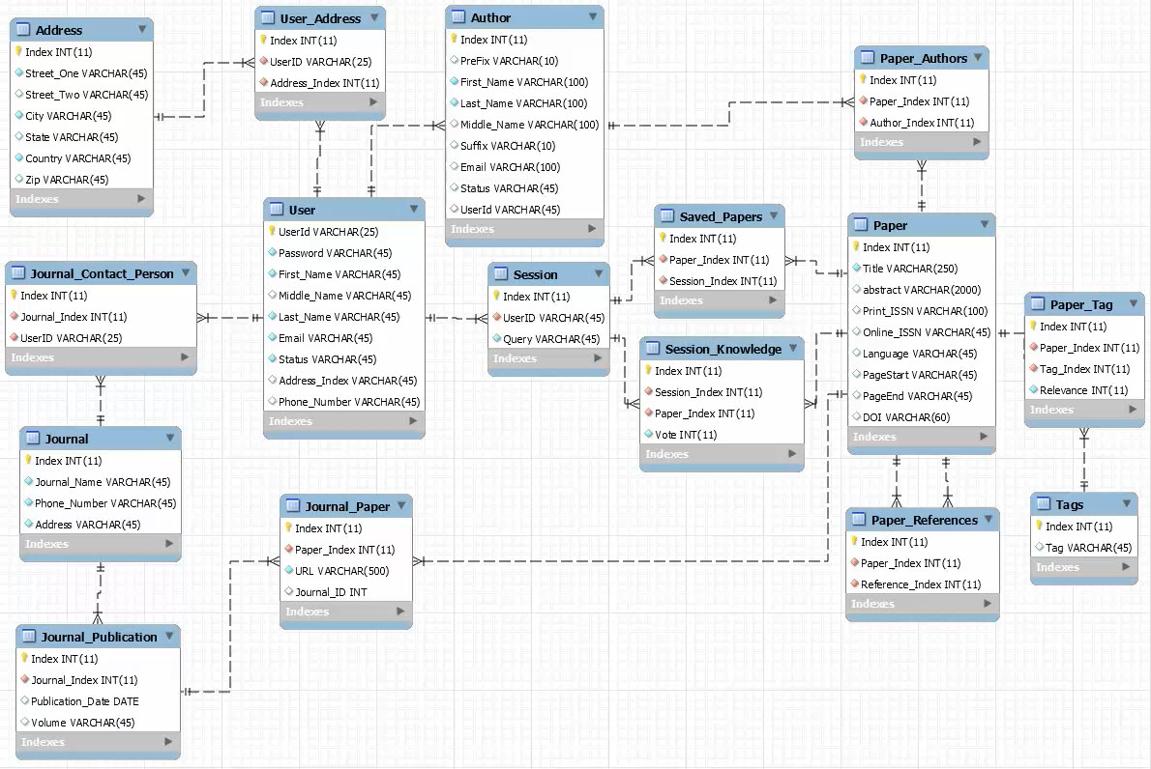

ER Diagram
MySQL database being hosted on Amazon Web Services
Third Normal Form
Database designed for growth
Notes:
The database was developed using mysql workbench. It is being hosted on Amazon Web Services. Due to this being a classroom project we have opted for the free hosting which allots us 1GB ram.
(we can do research here to see how much a query uses of that RAM to determine per user cost)
The database normalization was targeted at the third normal form. This allows the team to make relational connections to the database with only using a single key, this also reduces unnecessary columns in tables.
The database was over designed, to allow for growth in other areas that we have not yet tapped into. I am going to talk about each table and how it relates to the other tables, I will indicate which tables are currently in use and where there are opportunities built in for growth.
Main tables
Journal -
Journals are at the center of publications and each publication is comprises many papers.
The information we are trying to capture in the Journal is the name phone number and address. We are currently only using the Journal_Name. If the project were to continue we would try and reach out and get a contact for each of the journals we are dealing with to possibly get a better connection to their database system. The address could be used to send correspondence that that Journal
Journal Publication
The connection between Journal and Paper is through a journal publication. Journal publication is an issue of a journal. We store the publication date of the papers here.
Paper
Paper is one of the major tables and interacts with all the other tables. The columns that we are currently using in Paper are Title, Online ISSN, Page start and page end, and DOI. areas for growth we could try and find a way to pull the abstract and to possible get a print issn by working with another system to cross reference it.
Journal_Paper – This is the connection between the Journal publication and the paper itself. This is also where the URL is store for that individual paper. It is possible for a Paper to be published in multiple journals, that is the reason the URL is in the Journal_Paper table instead of in the Paper table itself.
Tags – Tags are the concept that Watson generates, when tags are being assigned to a paper using the Paper_Tag table, if that tag is new, there is a trigger that will create it in the tags table.
User – The current method that we use to create users is through Google accounts, google provides us with information that we store here. There is space available to store information not provided such as the users street address
Author – The Author is a table that we are currently not using. While using Springer, it returns all the Authors for the papers that were pull in a list. At this point we have not discovered a way to figure out how to find out which author belongs to which paper.
Session – A session is created with each new query
Session_knowledge – During a session a user can up and downvote papers, a user can also save papers. This is where those voting parameters are stored.
Saved_papers – Allows a User to save a paper to a session.
Addresses is currently not being used due to no information.
Journal Contact Person – if we were to expand on this project, we would like to have contacts for the Journals that our search engine deals with. This may allow for better connection to these journals.
Session -
Author -

Slide 7
The Voting Algorithm
There are 3 ways a user can “vote” on a paper
Saving the paper 2 point
Up voting a paper 1 point
Down voting a paper -1 point
When a user votes it saves in the database the paper, type of vote, and the session of that user.
The way the algorithm works is simplistic in its execution.
It looks at the papers and how they were saved and their concepts
It reviews all the papers that were pulled by the original query and determines their concepts.

Slide 8

The Voting Algorithm
There are 4 possible outcomes of each concept for each queried paper.
Example of a voteTotal (“cancer”, +1, -1, +2 -> 2)
1. A voted concept exist in paper and that is concept also in the query
$x=\frac{voteTotal}{4}∗(relevanceof concept)$+$\left(relevanceof concept\right)$
2. A voted concept exist in paper and does not exist in the query
$x=\frac{voteTotal}{4}∗(relevanceof concept)$
3. A voted concept does not exist in the paper but does exist in the query
$x=\left(relevanceof concept\right)$
4. Neither the voted concept exist nor is the concept part of the query
$x=0$
Score for paper$=\sum_{n=0}^{Concept total of paper}{\left(score of concept\right)}$

Slide 9
Thankyou
Notes:
Thankyou for watching our presentation
We have included the links to our application and our paper in the description.
We plan to continue working on and improving this project so we would really appreciate any constructive feedback.

